Slide 1
Lecture 3b
The Physical Layer (2): Signals

Slide 2
Information Vs. Data
Information depends on “uncertainty” and “surprise”
Consider
The sun is rising in the east
I see a herd of elk near my house
I see a red dragon
^{Which has the most surprise?}
Which has the most information?

Slide 3
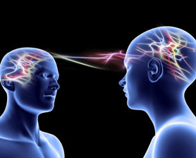
Mind Reading Vs. Speaking
Your thoughts are “encoded” into words
Words are carried by audio signals
Mouth = Transmitter (Tx)
Ear = Receiver (Rx)
http://static.ddmcdn.com/gif/mind-reading-120131-676450-.jpg

Slide 4
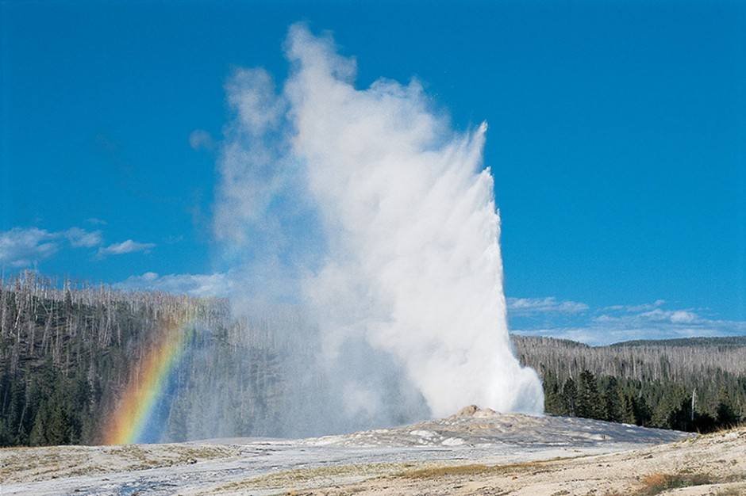

Speaking (Audio Signal)
http://indianapublicmedia.org/amomentofscience/files/2009/07/3705-940x626.jpg
http://amotherworld.com/main/wp-content/uploads/2010/11/kids.jpg
So grand, it is inspiring me
She says it is impressive…
Alice
Bob
It is sublime
Did she want a subway sandwich?

Slide 5
Information -> Data -> Moving Data
Slide modified from Agrawal
How can we move information from one location to another (assuming a channel exists)?
Data
Encoding of information (digital or analog?)
Representation of facts in a formalized manner suitable for communication, interpretation, or processing by humans or by automatic means
Example: Word document or numbers in computer spreadsheets
How do we move data from one location to another (assuming a channel exists)?
What are the properties and impairments associated with these techniques?

Slide 6
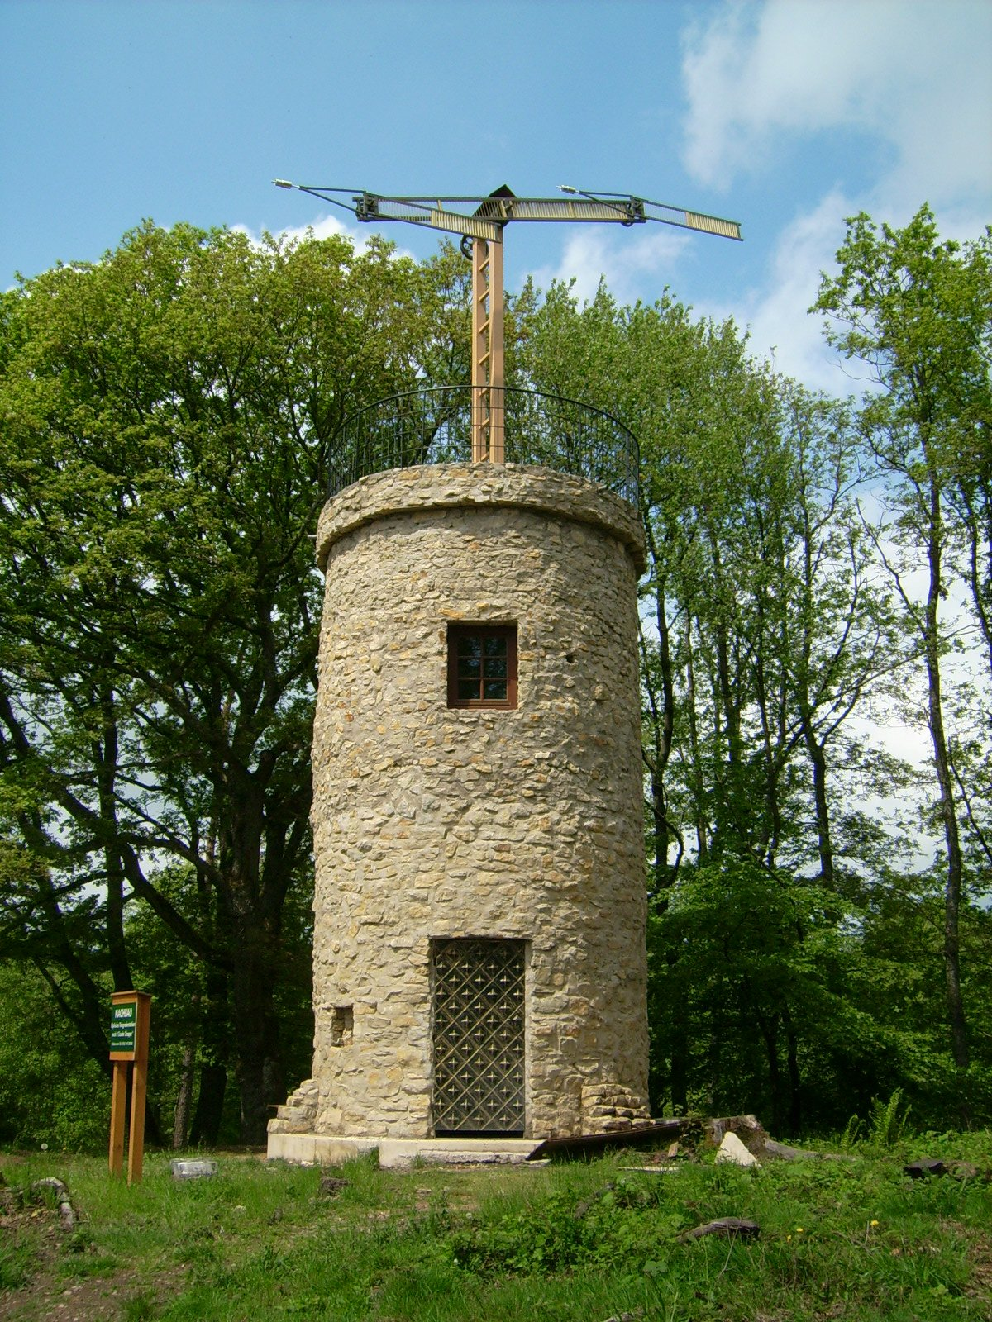
Historical Strategies
http://upload.wikimedia.org/wikipedia/commons/9/94/OptischerTelegraf.jpg
Physical
Mail
Carrier pigeons
Touch
Acoustic
Speech
African drums
Optical
Smoke signals
Semaphore tower chains

Slide 7
Signals
Slide modified from Agrawal
Signal
Detectable transmitted energy that can be used to carry data or
A time-dependent variation of a characteristic of a physical phenomenon, used to convey data
Example: voice in humans or wire voltage in computer networks
Electrical or optical energy, RF waves
We will focus on electrical energy, maybe RF waves
Typically a voltage on a wire
Must be changing over time to carry information

Slide 8
Signals (2)
Mathematically, a signal is represented as a function of time – or can be expressed as a function of frequency
Example: s(t) or S(f)
Communication systems perform the tasks of
Signal generation (conversion of information to signal)
Signal transmission
Signal reception
Signal detection (conversion of signal to information)

Slide 9
Simple Tx-Rx-Channel
The source produces a signal in time – s(t)
Example: When we speak, an audio signal is created
Example: When we speak into a microphone, the audio vibrations are converted into an electrical signal
The channel carries the signal to the sink (for now, transmission medium)
Example: Air carries audio to ear
Noise – n(t) – is a signal that distorts s(t)

Slide 10
Signals and their properties
Slide modified from Agrawal
Signals are changes in energy that can be detected at the receiver
Good signals can provide
Easy detection by receiver (simply tune in)
Immunity from noise (compare FM vs. AM)
Efficient use of bandwidth
Multiplexing
Combine many signals at sending end and separate them at the receiving end

Slide 11
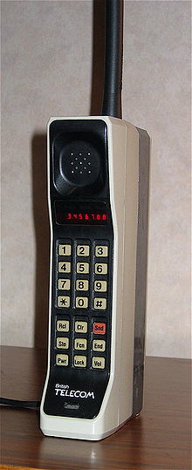
Impacts of improved signaling
Slide modified from Agrawal
Easy reception
CDMA signals are much easier to detect than older analog signals
Modern cell phones require less transmission power to send detectable signals, and can be smaller in size
Noise resistance
FM has much better noise resistance than AM
Hi-fi music transmission is possible over broadcast radio using FM
See http://www.a-bc.co.uk/dab.html
http://upload.wikimedia.org/wikipedia/commons/thumb/7/74/DynaTAC8000X.jpg/220px-DynaTAC8000X.jpg

Slide 12
Impacts of improved signaling (2)
Slide modified from Agrawal
Efficient utilization of bandwidth
Data compression and improved signaling allow eight hi-definition TV channels to be transmitted using the same bandwidth as one traditional analog TV channel
The remaining bandwidth is being auctioned for cell-phone usage
Multiplexing
Radio, TV, cell phones, fire, police, wi-fi and other users can easily transmit signals over the same medium (air)

Slide 13
Categories of signals
Slide modified from Agrawal
All signals involve creating change at the sending end that can be detected at the receiving end
Common approaches
Turn a switch on or off depending upon whether data to send is 0 or 1 (digital signal)
Create a sine wave and change (modulate) its amplitude or frequency, hence the names AM and FM (analog signal)
Analog Signal

Slide 14
Analog Signals
Continuous variation in time
Information is contained in each absolute signal level at each point in time
Amplitude(volts)
Time (seconds)

Slide 15
Digital signals
The amplitude values take on a finite set of values
Information is contained in discrete, well defined levels
Two-levels => binary
Multiple levels
M-Ary for M levels
Still carry bits!
Amplitude(volts)
Time (seconds)

Slide 16
Periodic and Aperiodic Signals
Periodic: pattern repeated over time (e.g., sine wave)
Aperiodic: no repeated pattern to the signal
Notes:
We have to characterize signals so that we can determine their properties. This can be done analytically, but we will take a qualitative approach. The analytical characterization of signals will be covered in Telcom 2060.
Characterizing the signal allows us to consider the ability of signals to carry information under a variety of circumstances. You will recall that different cable types had different susceptibilities: UTP had high attenuation and noise susceptibility, both of which were reduced by STP, coax, and, finally, optical fibers.

Slide 17
Sinusoids (1)
What is the frequency?
Sinusoids are periodic
The idea of “frequency” is easiest with sinusoids
Typical form: s(t) = Acos(2πf_{c}t + φ)

Slide 18
Sinusoids (2)
Frequency (f_{c})
Number of repetitions per second (unit is hertz): 5 KHz → 5000 times per second
Period (T) - amount of time it takes for one repetition of the signal
T = 1/frequency = 1/f 5KHz → T = .2 ms
Phase (φ) - measure of the relative position in time within a single period of the signal
Wavelength (λ) - distance occupied by a single cycle of the signal
For electromagnetic waves in air λ = c/f where c is the speed of light = 3 x 10⁸ m/sec

Slide 19
Some Sinusoids

Slide 20
Some Trigonometric Identities
What is cos 2A?
What is cos 0?
What is sin 2A

Slide 21
Why sinusoids and trigonometry?
Fourier Series
Any periodic signal can be broken into a sum of weighted sinusoids
The frequency f₀ is called the “fundamental” frequency
Multiples of f₀ are called “harmonics”
We only need the “weights” C_{n} to get the actual signal (discrete)
Think of the weights as “how much energy is there at that frequency”

Slide 22
Example
Bandwidth

Slide 23
Clarinet and Violin
The violin and clarinet play the same note A sinusoid at the note’s fundamental frequency f₀ For example, f₀ = 440 Hz for “middle A”
Both the violin and clarinet would sound identical like a tuning fork, but they don’t!
Clarinet’s tube and violin’s string add harmonics Infinite number of harmonics – but weights C_{n} are different
Similarly, human voice and speech have distinguishing weights

Slide 24
Aperiodic Signals
They have a continuous range of frequencies in them
No longer just the harmonics
A fat aperiodic signal has a smaller range of frequency content
A thin aperiodic signal has a larger range of frequency content
Bandwidth
Bandwidth
time
frequency
time
frequency

Slide 25
Bandwidth
Measure of the range of frequencies in a signal Half-power bandwidth
Interval where spectrum falls to ½ the maximum value
Null-to-null bandwidth - Width of the mainlobe of the spectrum
Fractional containment bandwidth - Width of the spectrum that contains 95% or 99% of the power (FCC)
Out-of band emission level - Width of spectrum beyond which the spectrum value is some dB below the maximum

Slide 26
Spectrum and Bandwidth
Spectrum – a range/continuum of frequencies.
Radio Spectrum 0 – 300 GHz
Visible Spectrum 400 – 790 THz
Band – a small slice of the spectrum
USA AM Radio band 530-1710 kHz
Absolute bandwidth - width of the spectrum of a signal
Effective bandwidth (bandwidth) - band of frequencies that contains most of the signal’s energy
Example: human voice – absolute bandwidth 0-20 kHz, effective bandwidth 50 – 3400 Hz.

Slide 27
Frequency and Time
A signal can be represented in frequency or in time
If we look at frequency, we call it the “spectrum” of the signal
This is a loose and simplified definition
Signals can “interfere” in time or in frequency
What if the kids started shouting at a different time?
How about an ultrasonic dog whistle?

Slide 28
Filters
Filters allow certain frequencies to go through and stop other frequencies
Useful for separating multiplexed signals
The attenuation and phase of different frequencies can be affected differently
Channels (transmission media) are often like filters

Slide 29
Types of Ideal Filters

Slide 30
Key Takeaways
The frequency domain representation helps us understand bandwidth more precisely
The bandwidth of a signal consists of its frequency range
Signals with shorter periods (or thin in time) have greater bandwidth than signals with longer periods (or fat in time)
Later
Different digital signals (line codes) have different bandwidths

